Slide 1
Self-service Monitoring of HPC and Openstack Jobs for Users
Simon Guilbault (simon.guilbault@calculquebec.ca)
Notes:
20 minutes including questions

Slide 2
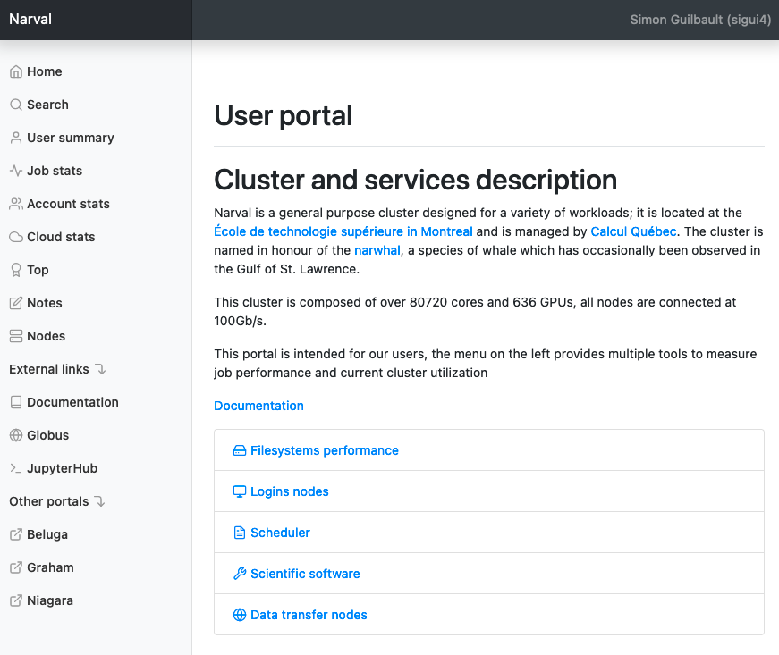
Quick overview of the portal
Live demonstration of a staff view
Public view of some information
https://portail.narval.calculquebec.ca/
Notes:
https://portail.beluga.calculquebec.ca/secure/jobstats/ghungbt/40081871/ or any other jobs

Slide 3
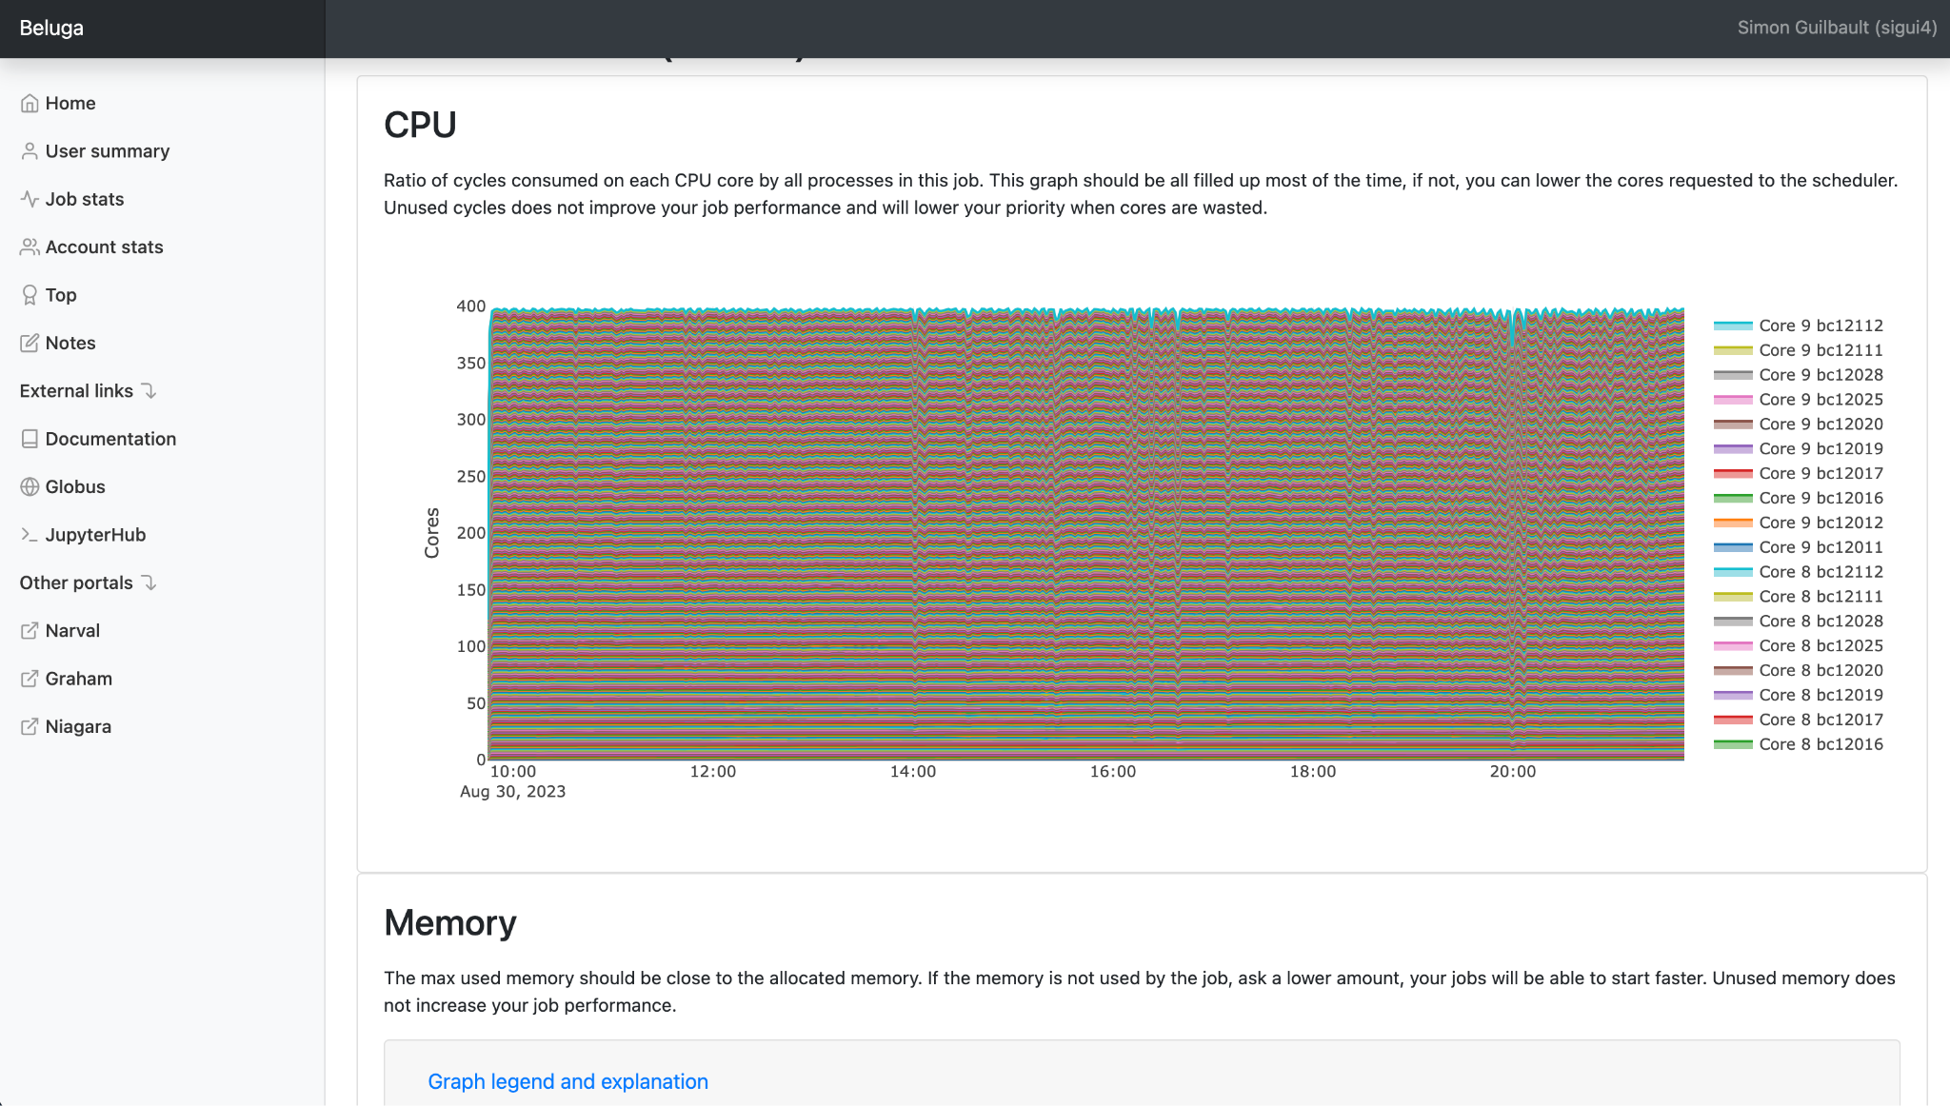
Quick overview of the portal

Slide 4
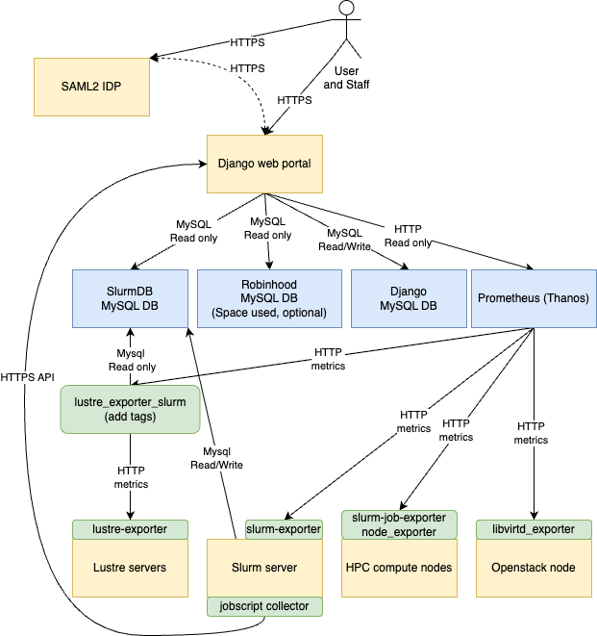
Data flow and collectors
The portal: github.com/guilbaults/TrailblazingTurtle
slurm-job-exporter
node_exporter
slurm-exporter
lustre_exporter + lustre_exporter_slurm
redfish_exporter (power by node)
libvirtd_exporter (openstack)
pcm-sensor-server (Intel IPC/NUMA/Mem)

Slide 5
Prometheus
Thanos
1866 nodes monitored
200k metrics per second
1 VM per cluster
50GB of ram
6 cores
300GB of local disk
10 IOPS
Cardinality is not a issue for jobstats
Recorder rules to generate sums
Plugin over Prometheus for archival and multiple endpoints
3.5+ clusters monitored
27TB in S3 (ceph)
6 months of retention for everything
Rewrite after 6 months to remove some stats
Downsampling is disabled
Downsampling increase storage req.
Too many small jobs
Queries over the last year are rare

Slide 6
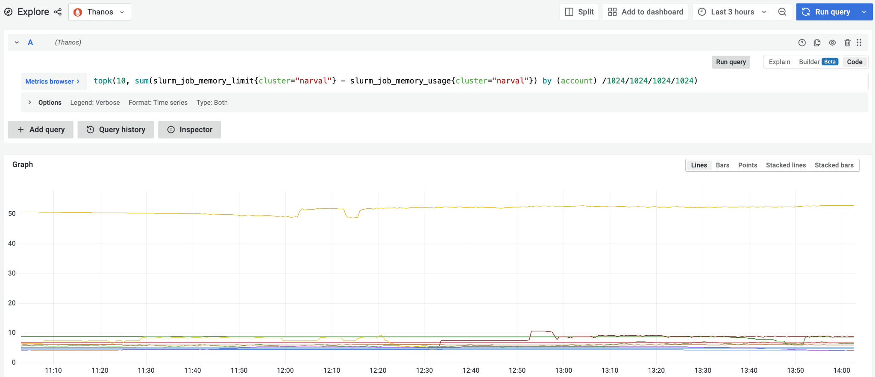
Initial prototype and exploration in Grafana
Simple query to get the 10 worst memory waster by user
Not user friendly and only available to sysadmins

Slide 7
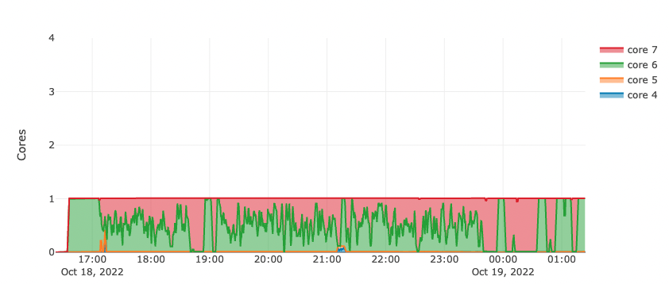
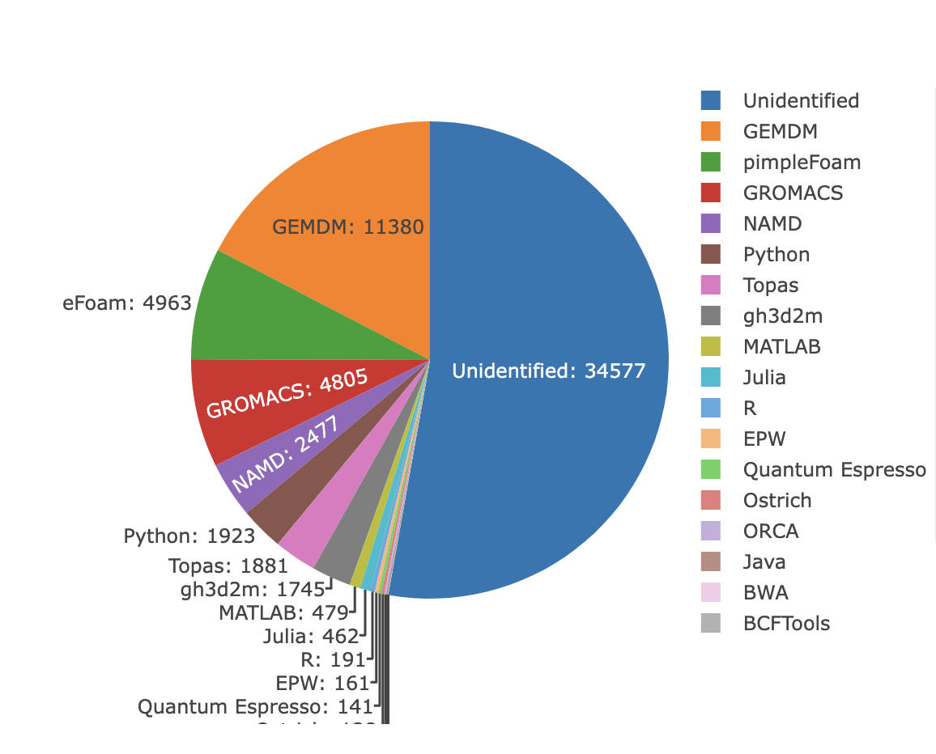
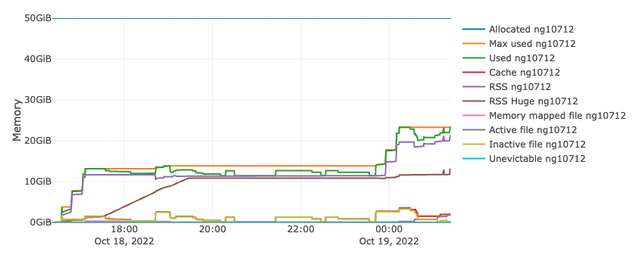
slurm-job-exporter
cgroups statistics
CPU
Memory
Application name
Processes and threads count

Slide 8
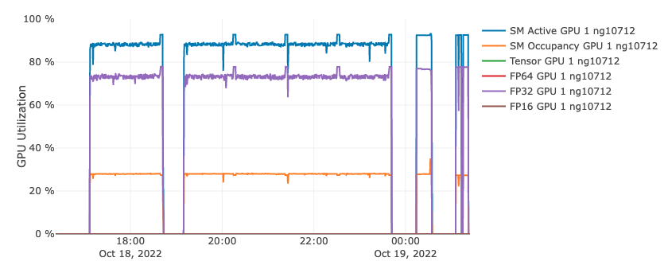
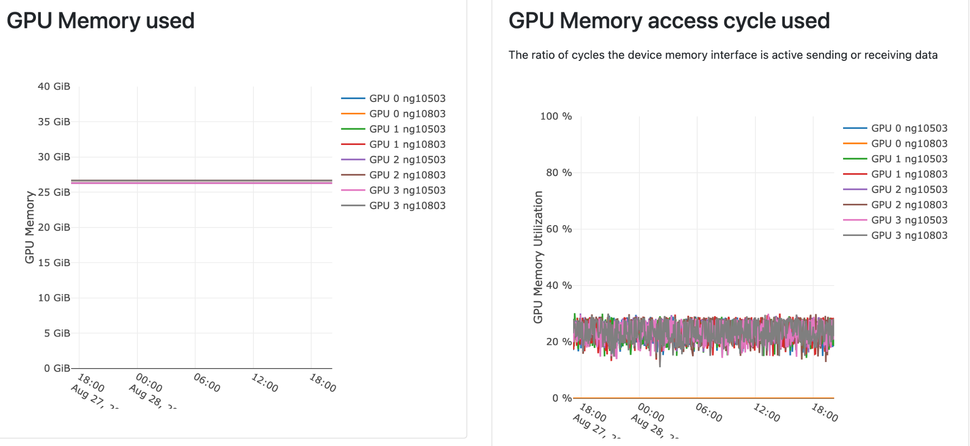
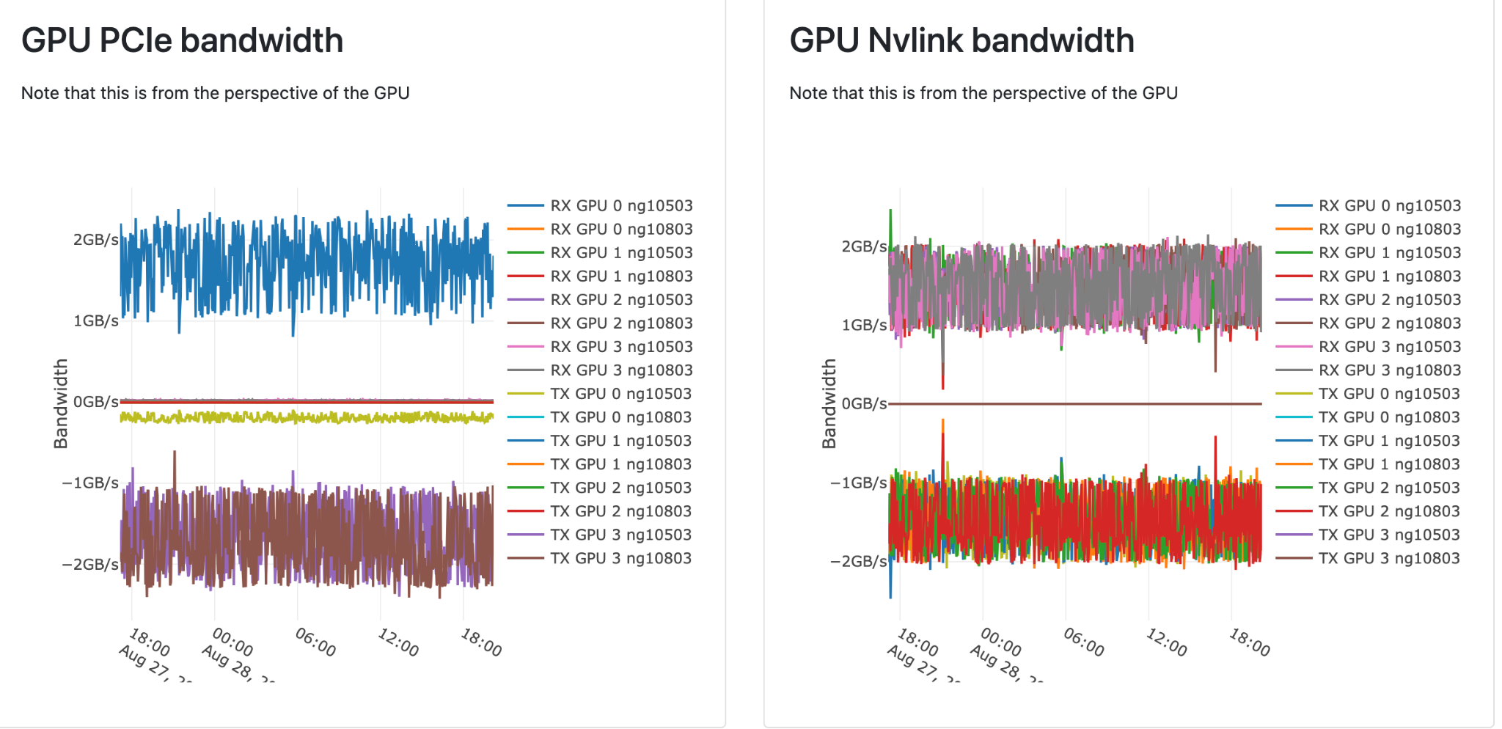
slurm-job-exporter
Use Nvidia DCGM, include MIG stats
SM active/occupied
FP64/32/16/Tensors
Memory bandwidth
PCIe and Nvlink bandwidth

Slide 9
node_exporter
redfish_exporter
Local disk
IOPS
Bandwidth
Used space
Network
Ethernet and Infiniband
Unix load
CPU
Memory + NUMA
ZFS
Grafana node-exporter full
Power
iDRAC does some averaging over time
Fans
Temperature

Slide 10
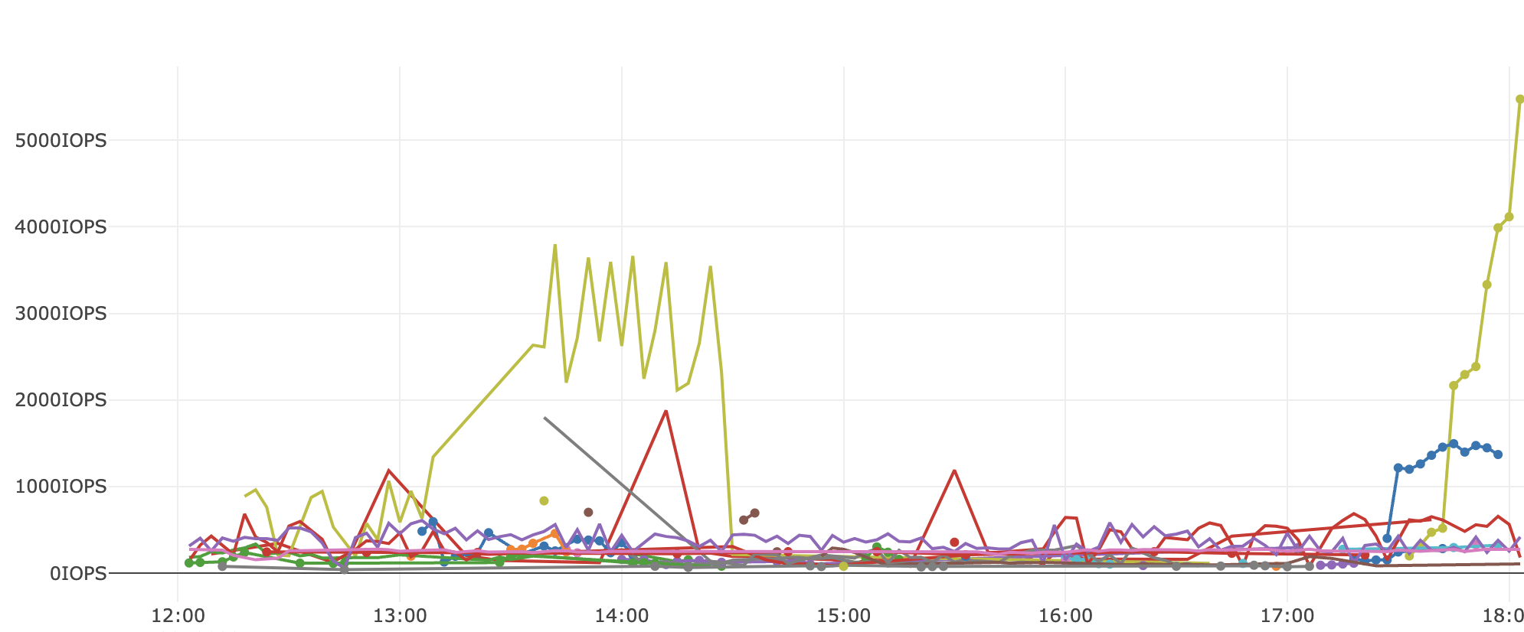
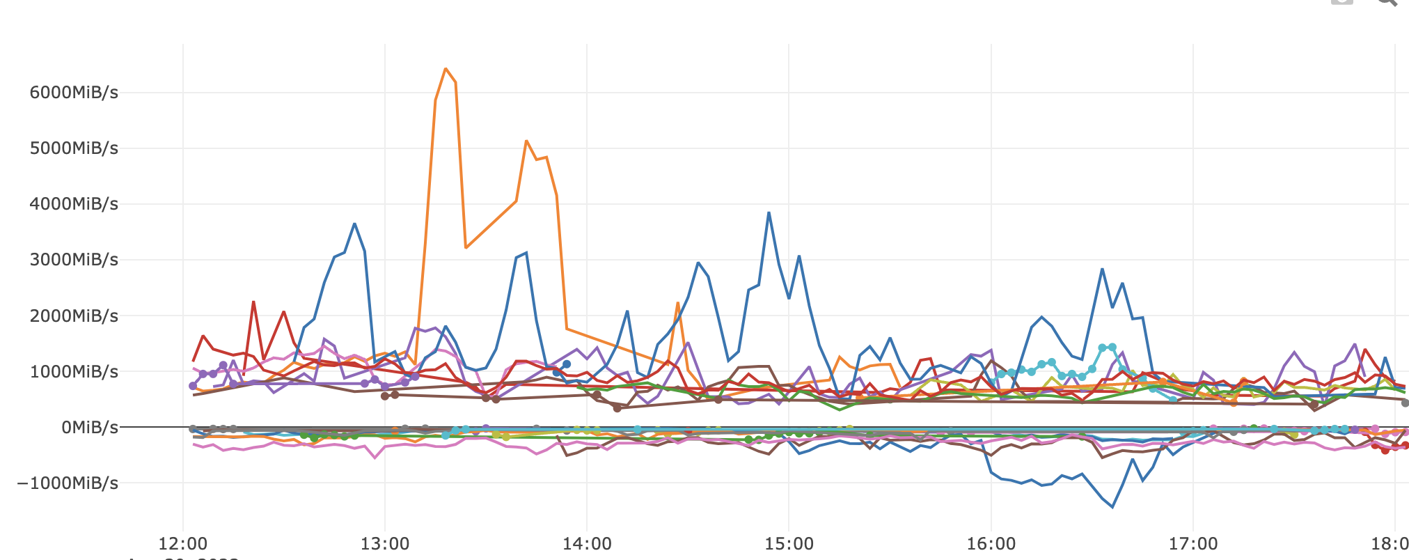
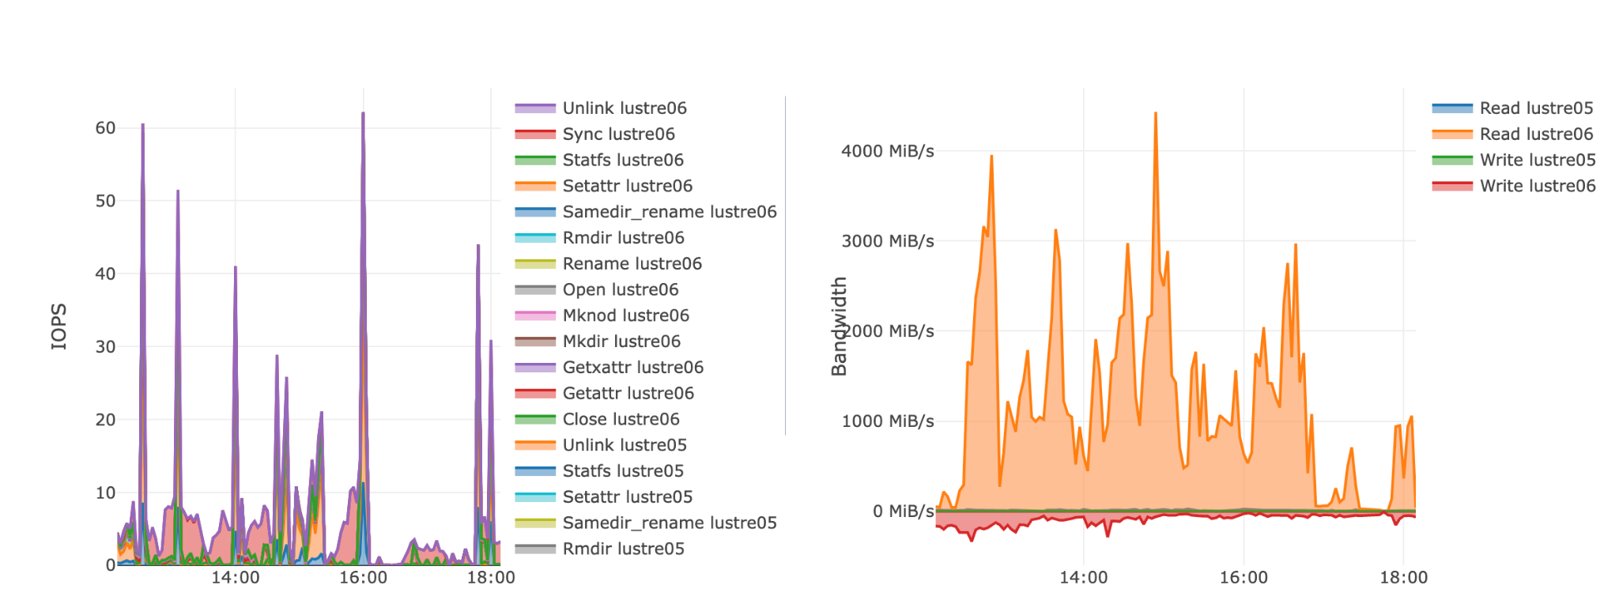
Lustre
Top users for bandwidth and IOPS
Usage for a user or a job

Slide 11
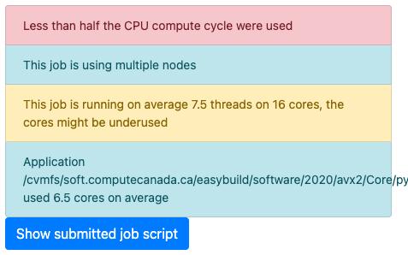
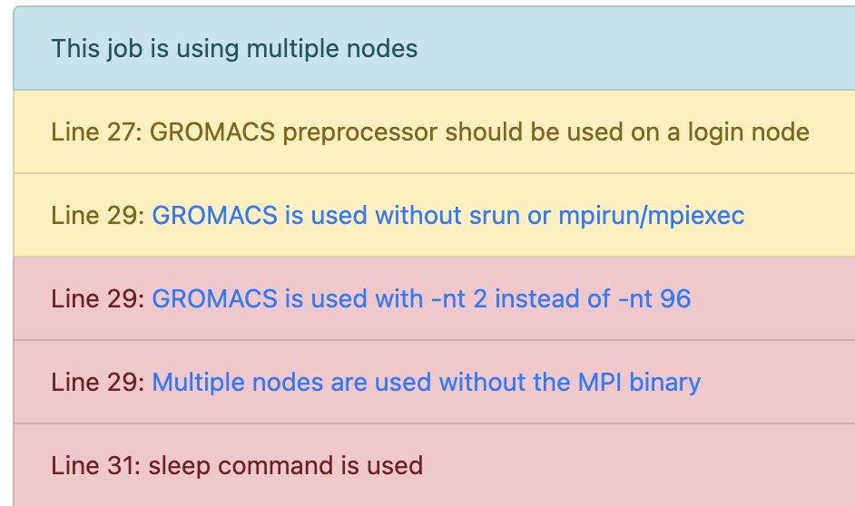
Automated Job analysis
Regex on job script
Stats from prometheus
Application name
#SBATCH --ntasks=96 # number of MPI processes
module load StdEnv/2020 gcc/9.3.0 openmpi/4.0.3 gromacs/2020.4
gmx grompp -f $mdp/emin_$LAMBDA.mdp
gmx mdrun -v -deffnm emin$LAMBDA -nt 2
sleep 10

Slide 12
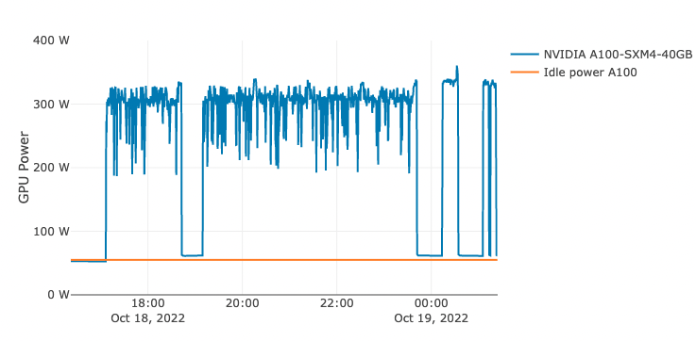
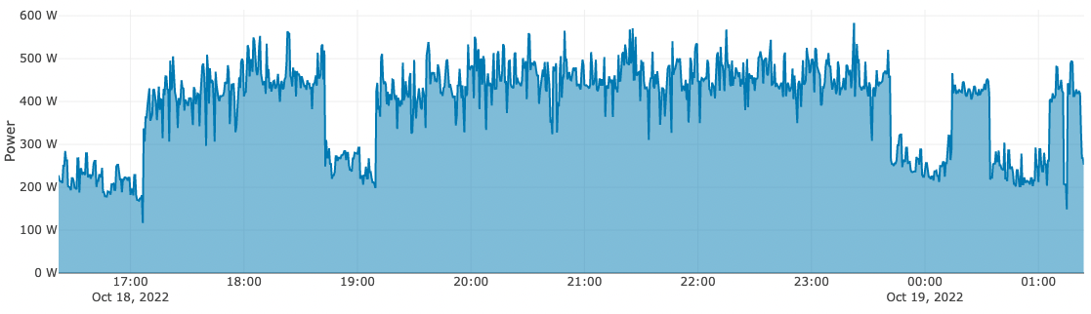
Power measurement
Power by node and by GPU
Allocate power of a shared nodes to the jobs running on it
based on % of cpu cores
by the GPU used

Slide 13
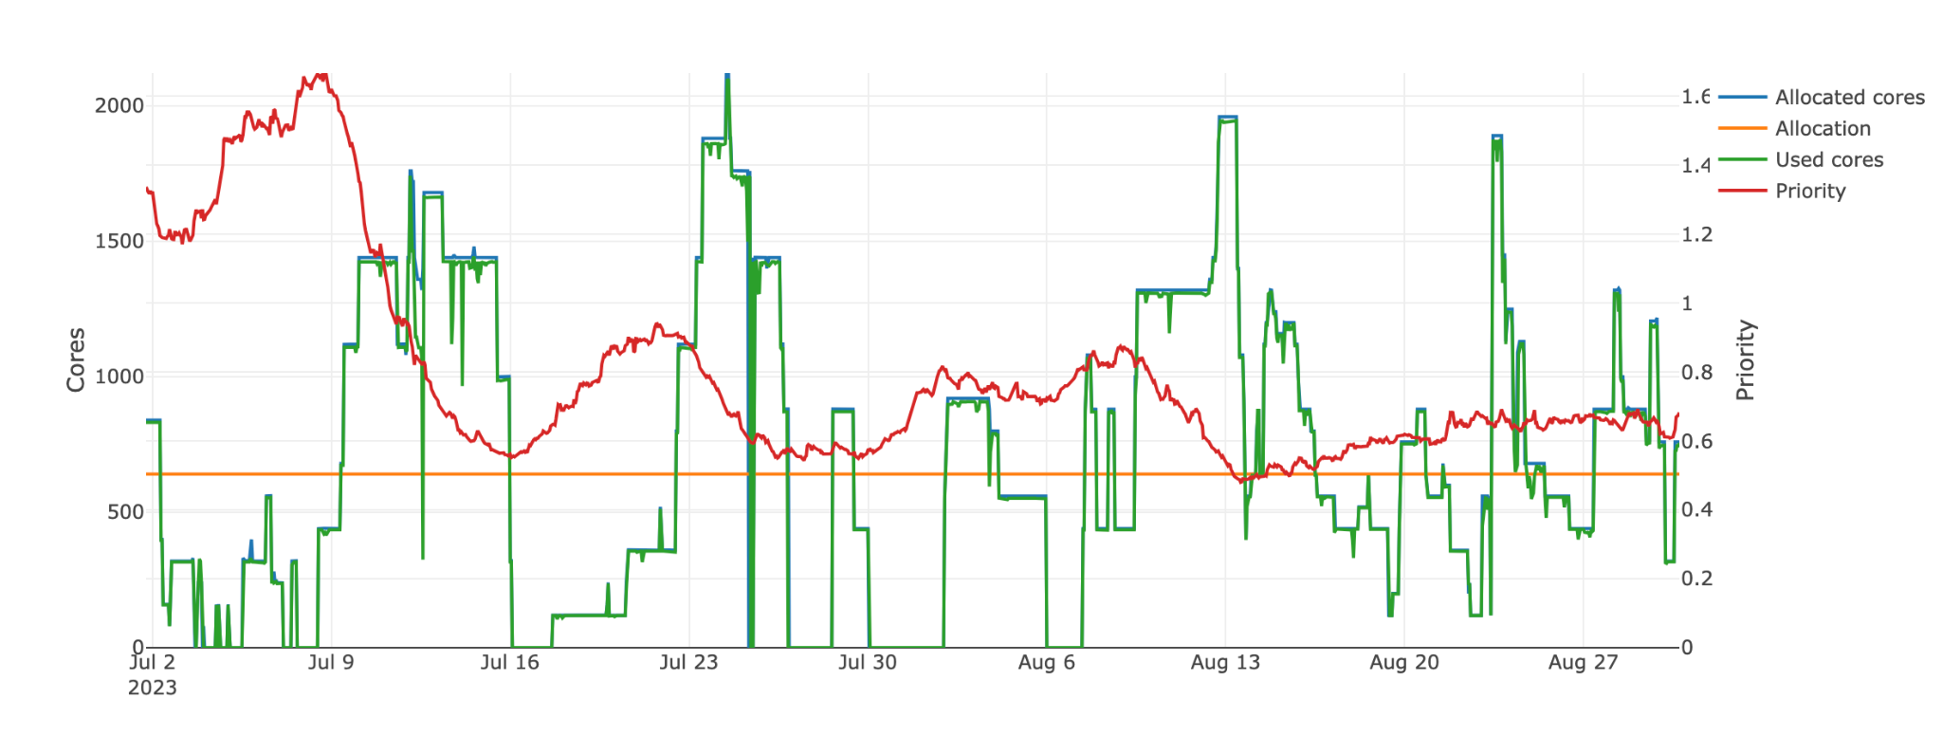
Priority and group use
Priority (levelFS) is around 0.6 because this group is using more than their allocation

Slide 14
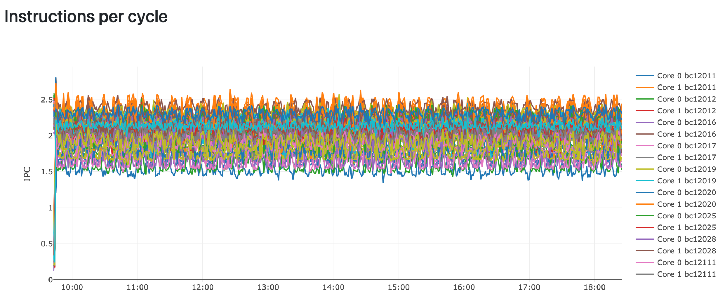
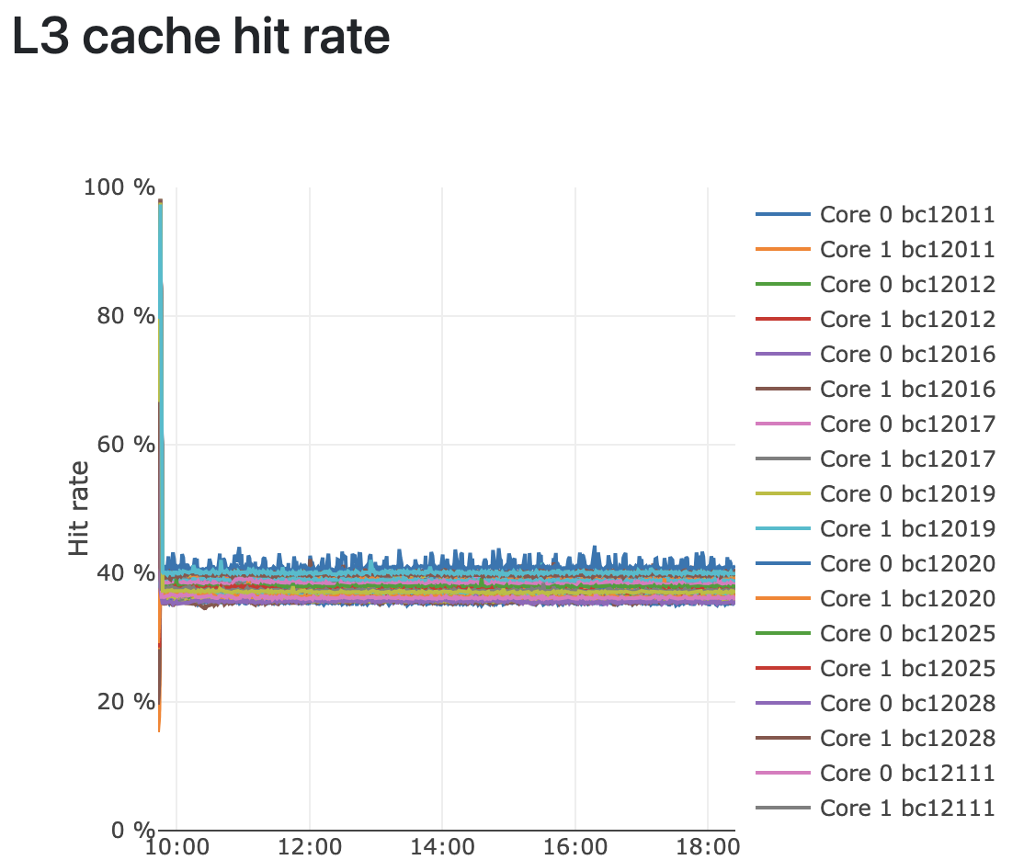
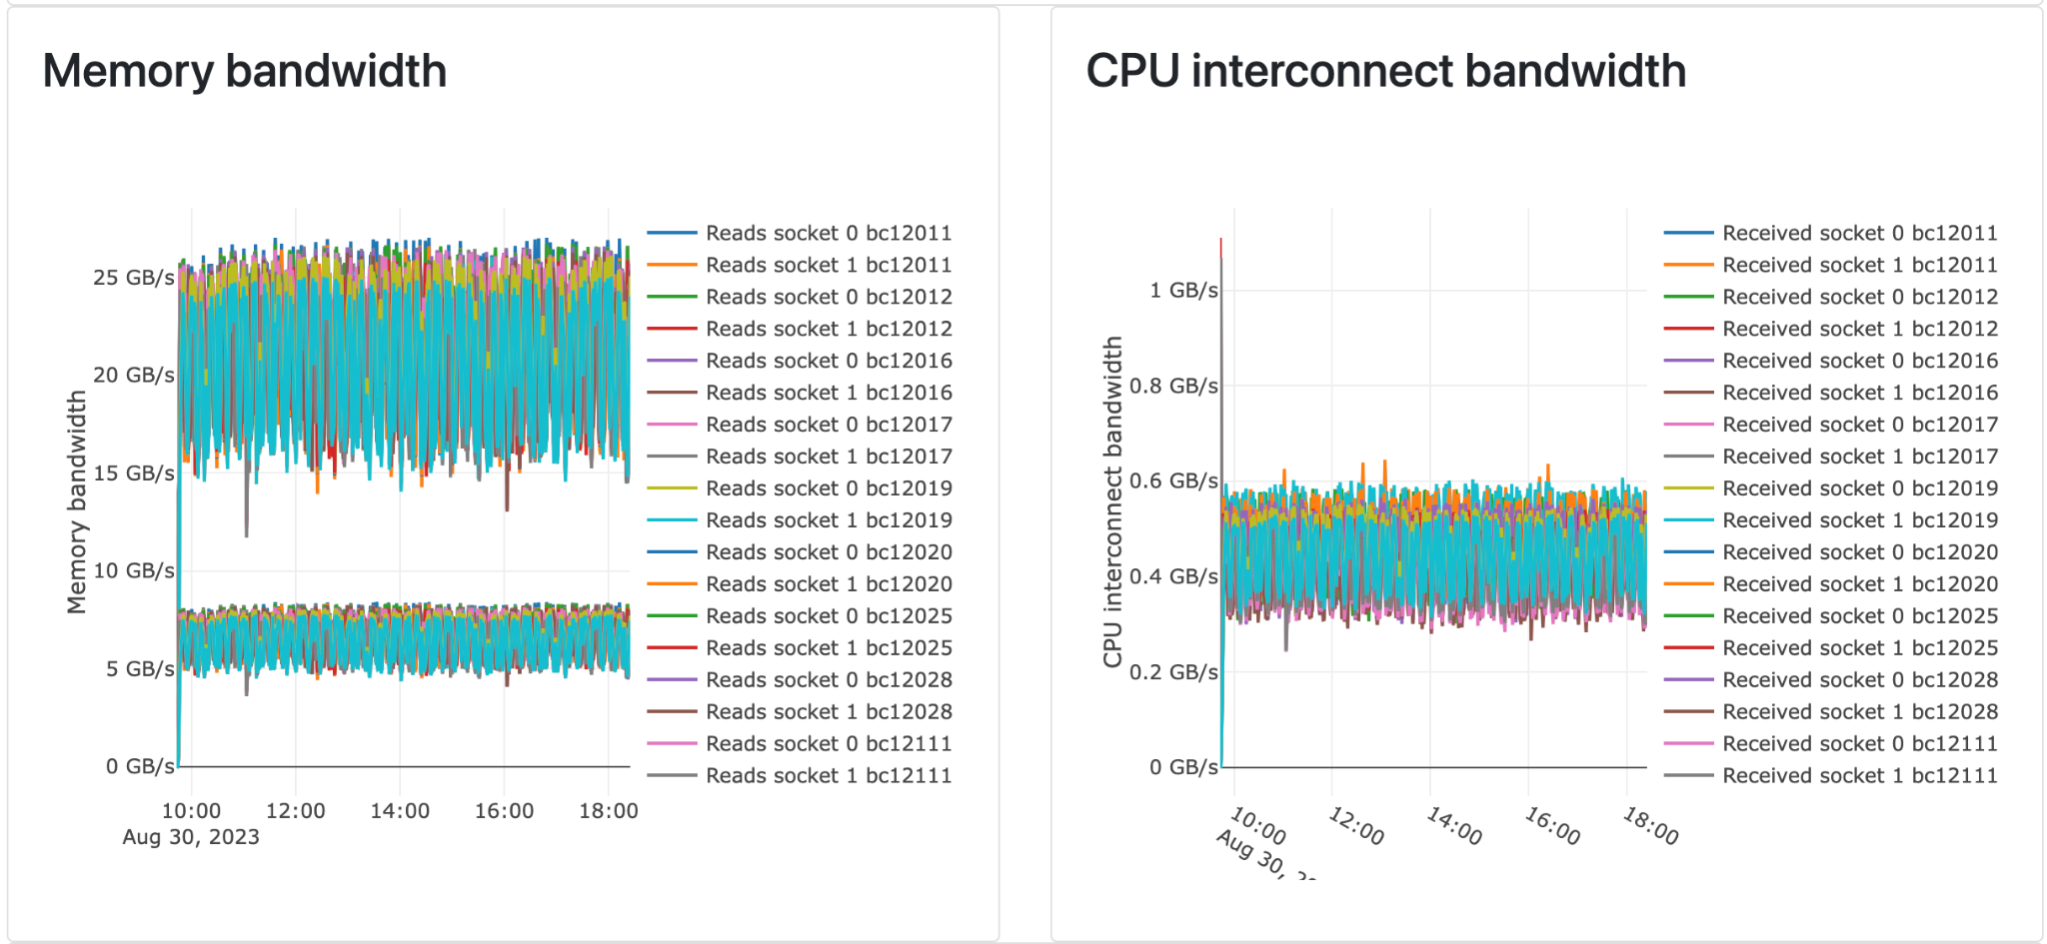
Intel pcm-sensor-server
AMD CPU are missing some counters for memory bandwidth and other metrics

Slide 15
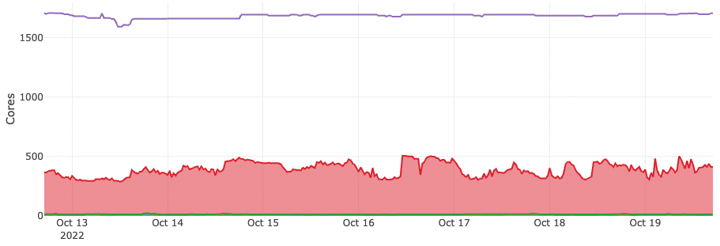
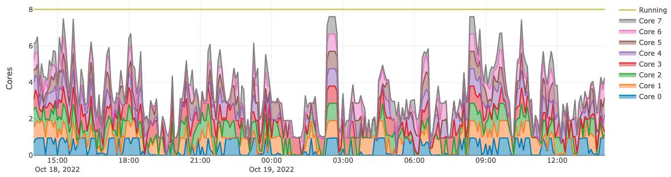
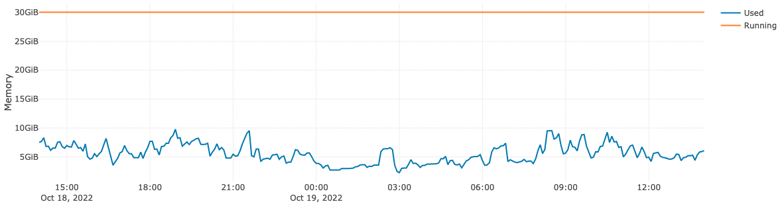
Openstack
Overall utilization
by project
by VM
Cores
Memory
Allocated
Balloon to see used
Network
Bandwidth
Packets
Block devices
Bandwidth
IOPS

Slide 16
Future improvements
Better automated job analysis
Simple score for each job/user/slurm account
Feedback on job script
Automatic alerts and killing jobs
What count as not using a GPU correctly ?
Improving the annual allocation process
Improving the next RFP based on the resources being used
Node fail additional informations from syslog
Tell the user the node died because of a DIMM
Analyse compiled applications by used CPU time
Language
Compiler
Clarification in MIG stats

Slide 17
Questions ?
https://github.com/guilbaults/TrailblazingTurtle/

